Slide 1


A Terragni
Case Study
Behavioural Science for Digital Journeys In Action
TERRAGNI CONSULTING (P) LTD PRIVATE AND CONFIDENTIAL ©

Slide 2

Client Background
Challenge
Objective
What We Did
Samples
Strengths
Opportunities
Solutions
Business Outcomes
5th
6 Lac+
Largest bank in Asia
Customers pan India
56084
3120
Employees
Branches
TERRAGNI CONSULTING (P) LTD PRIVATE AND CONFIDENTIAL ©

Slide 3

Client Background
Challenge
Objective
What We Did
Samples
Strengths
Opportunities
Solutions
Business Outcomes
Profitability and Customer Retention under pressure due to
Weak adoption of digital touchpoints for regular banking processes
High cost of customer service via physical channels (branches, contact centre)
Customer dissatisfaction with digital touchpoints detracting from overall customer experience with the institution
TERRAGNI CONSULTING (P) LTD PRIVATE AND CONFIDENTIAL ©

Slide 4

Client Background
Challenge
What We Did
Samples
Strengths
Opportunities
Solutions
Business Outcomes
Jump Deployed For All Regular Digital Banking Journeys For:
Making journeys simpler
Aligning journeys with user contexts
Incorporating behaviour science principles to drive adoption and usage
TERRAGNI CONSULTING (P) LTD PRIVATE AND CONFIDENTIAL ©

Slide 5
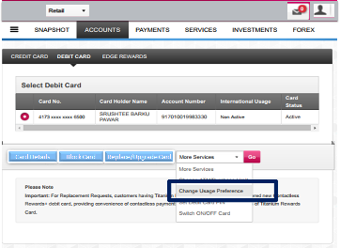
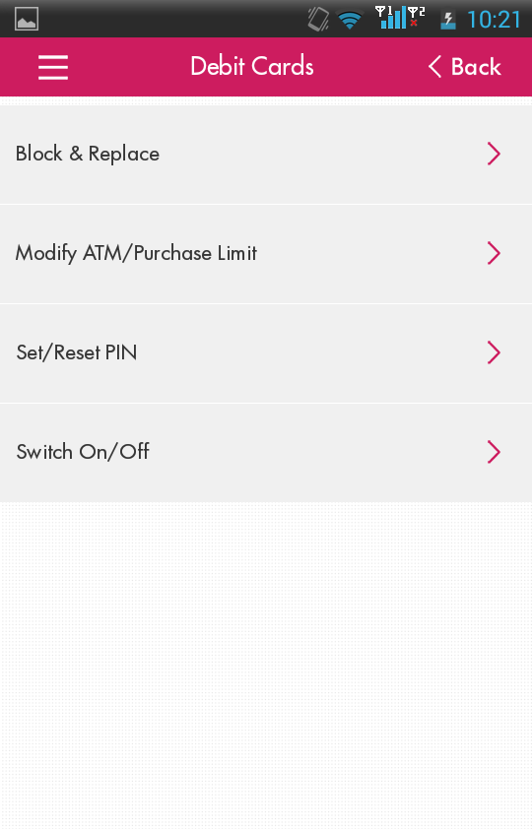


Inconsistent touchpoints
1
Users unable to find the ‘Change Usage Preference’ option on the mobile application. While this option was found in the Debit Cards section on the website it was not available in the corresponding section in the app.
Go
2
Familiarity Bias violated
Debit Card < Back
Inconsistent terminology
Block & replace only allows the customer to block the card.
No option available to apply for new card or to replace card.
Cognitive Effort
TERRAGNI CONSULTING (P) LTD PRIVATE AND CONFIDENTIAL ©

Slide 6
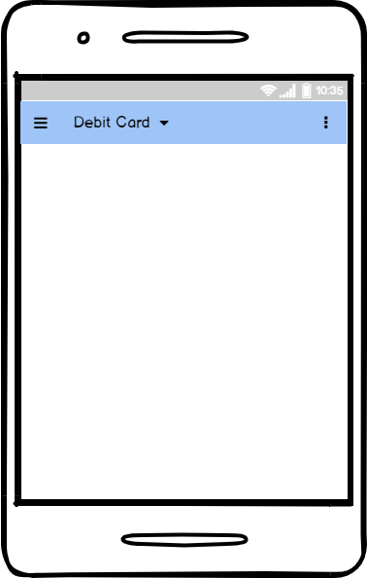
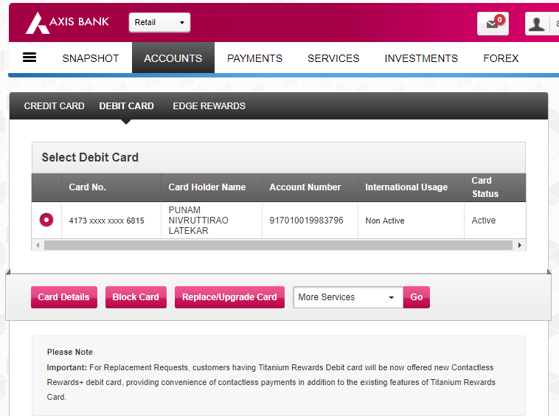






Chunking of functionality
Contextual Design Links changed to buttons to allow for ease of clicking, based on user observations
Application of Familiarity Bias
          BLOCK
        REPLACE
          NEW
          CARD
        UPGRADE
        CARD
SET/RESET PIN
BLOCK
REPLACE
NEW
UPGRADE
CHANGE USAGE PREFERENCE
SET/RESET PIN
CHANGE USAGE PREFERENCE
TERRAGNI CONSULTING (P) LTD PRIVATE AND CONFIDENTIAL ©

Slide 7
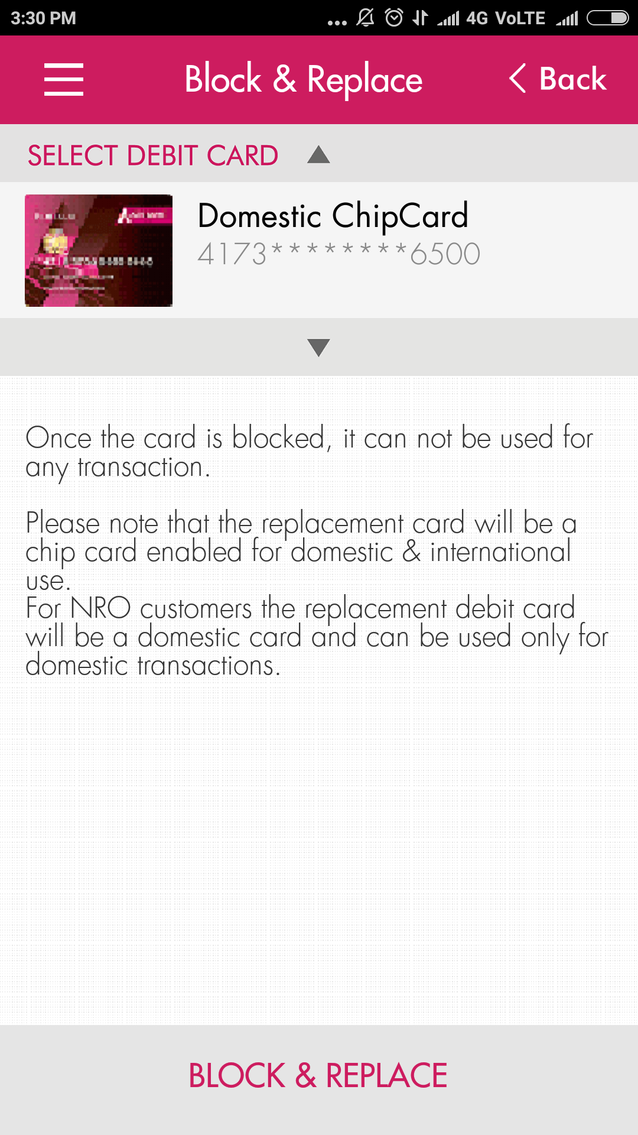
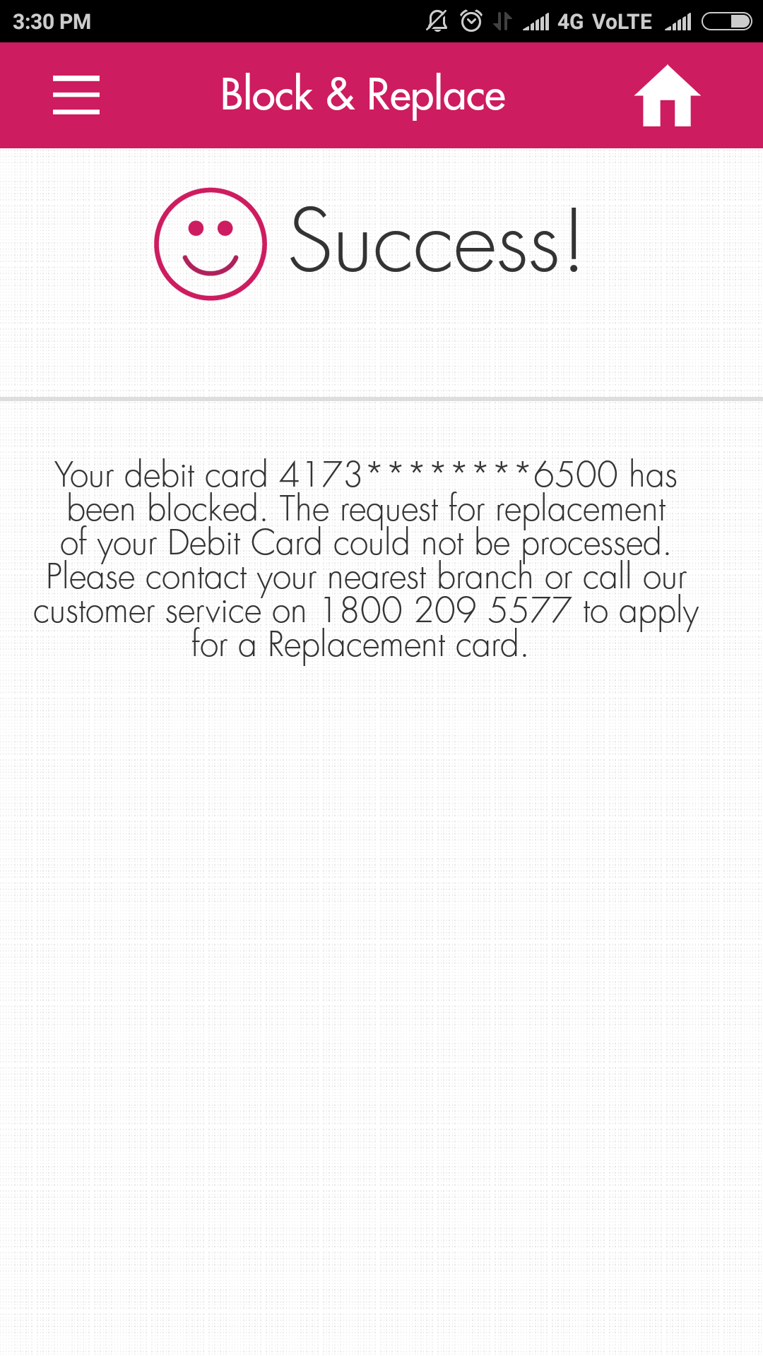

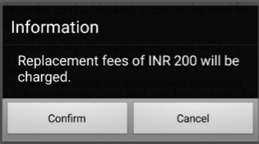
Key information not presented upfront
Block & Replace < Back
Block & Replace
Select Debit Card
Replacement fees information available on a different page
Adds a click, adding cognitive effort
4321********9876
Behavioural impact
High cognitive effort Perception of lack of transparency
Given the context of a financial product, this drives erosion of trust
4321********9876
Request not completely addressed
User request is only partly completed
No option available to continue with replacement of card Key details not placed intuitively
Block & Replace
TERRAGNI CONSULTING (P) LTD PRIVATE AND CONFIDENTIAL ©

Slide 8
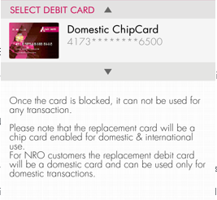
Block
Block
Select Debit Card
Alerts and key information about fees provided upfront
External trigger using Fresh Start effect
Application of Feed-Forward principle
Select Debit Card
All Done!
4321********9876
Your Debit card 4321********9876 has been blocked.
Once the card is blocked, it can not be used for any transaction.
Please note that the replacement card will be a chip card enabled for domestic & international use.
For NRO customer's the replacement debit card will be a domestic card and can be used only for domestic transactions.
Domestic chipcard replacement fee INR 200 will be charged.
For charges for other card types click here
          NEW
          CARD
Try something NEW from our other options
Get the same card re-issued in just one click
        REPLACE
BLOCK
TERRAGNI CONSULTING (P) LTD PRIVATE AND CONFIDENTIAL ©

Slide 9
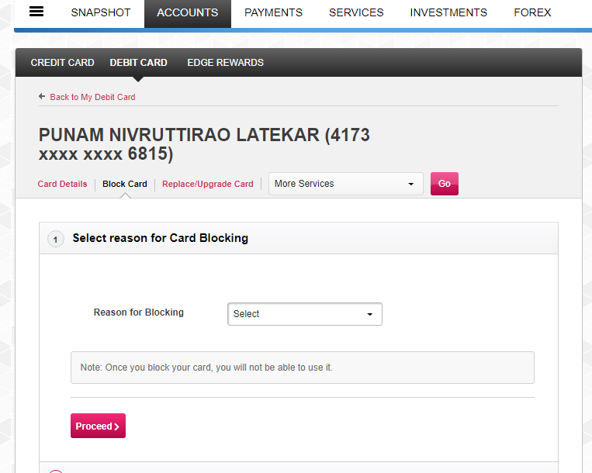
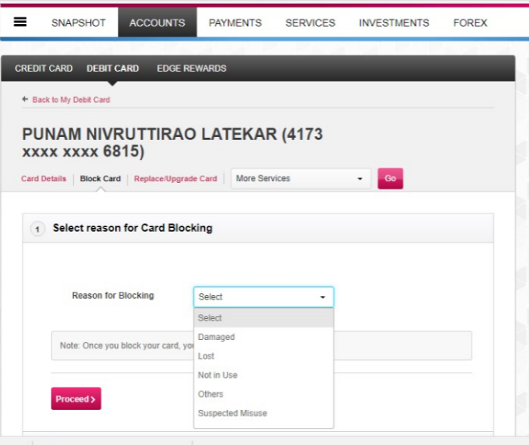
Readability challenge
Lack of visibility
Back to my card
Priya Sharma (4321 **** **** 9876)
User is not clear how many more steps are required and often abandons the journey here
Card Details
Upgrade/Replace card
Go
User is not able to easily discover the note about card blocking
Proceed>
Usability challenge
Back to my card
It takes the user two clicks just to select the reason
Priya Sharma (4321 **** **** 9876)
Card details
Upgrade/Replace card
Go
Behavioural Impact
High Perceived Effort associated with residual anger, lack of transparency and loss of trust
Absence of empathy magnified
Proceed>
TERRAGNI CONSULTING (P) LTD PRIVATE AND CONFIDENTIAL ©
Notes:
Not clear what the challenge is other than readability

Slide 10
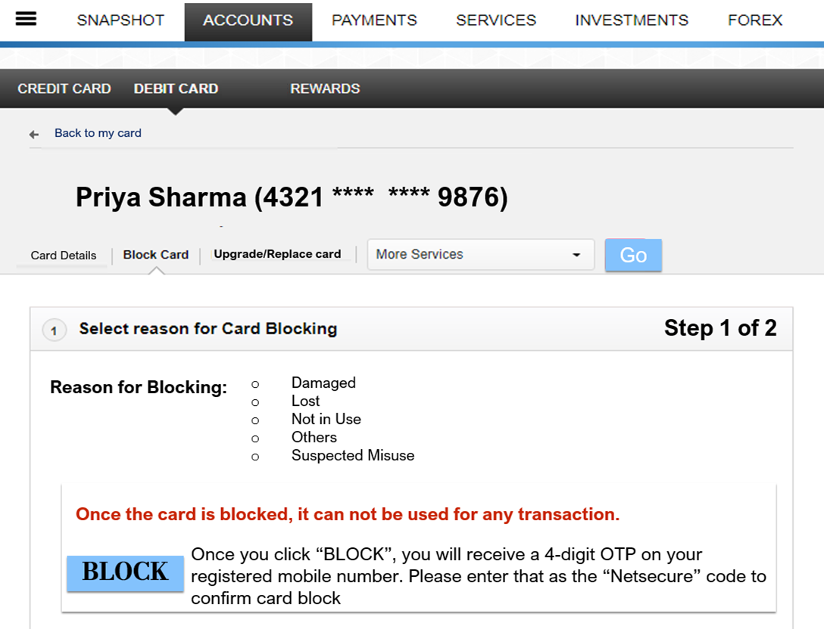
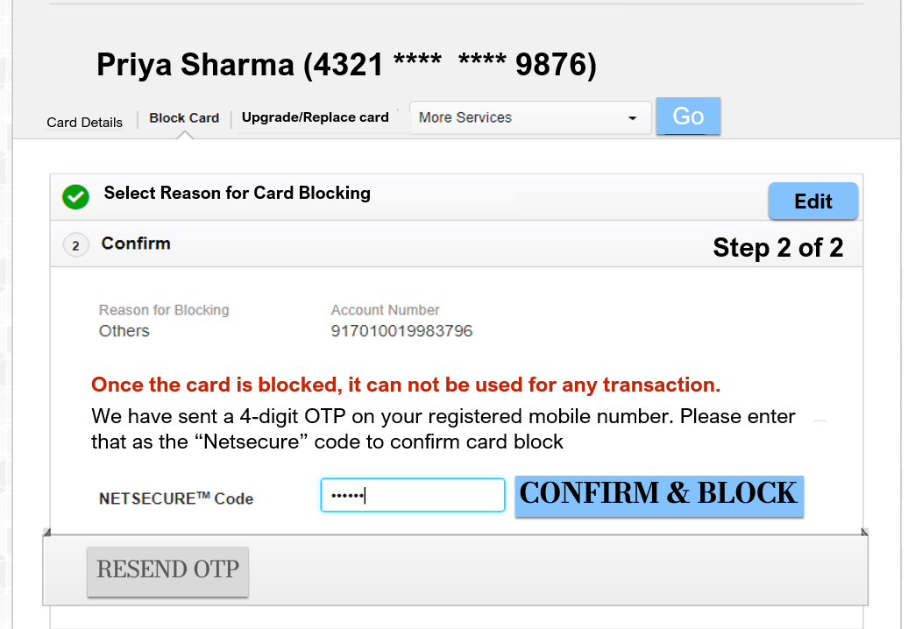
Application of Goal Gradient Effect
User input elements changed to drive better usability
Principles of Visual Hierarchy implemented to bring focus to important instructions
TERRAGNI CONSULTING (P) LTD PRIVATE AND CONFIDENTIAL ©

Slide 11
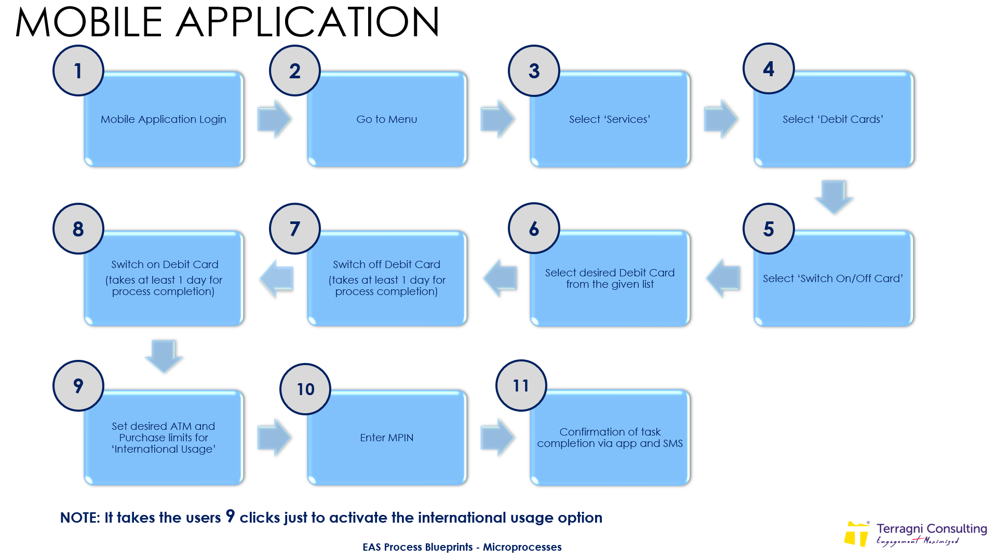

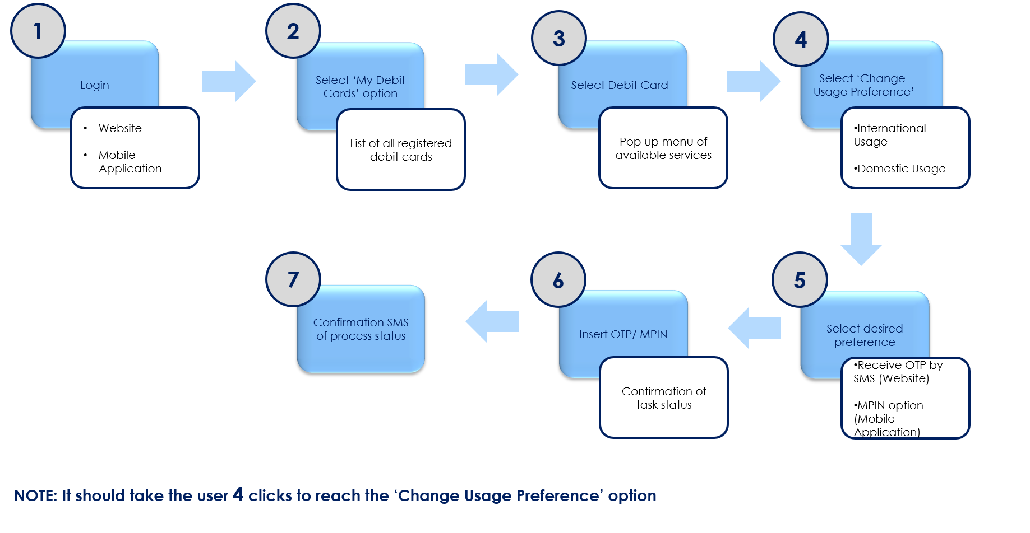
JUMP PROCESS REDESIGN
Before
Tedious
Complex
Time consuming
Behavioural Impact
Reduction in Cognitive Effort, Temporal Effort and Perceived Effort
Enhances perception of transparency and trust
After
Quick
Simple
TERRAGNI CONSULTING (P) LTD PRIVATE AND CONFIDENTIAL ©
Notes:
BEFORE AFTER SAMPLE

Slide 12

Client Background
Objective
Approach
Why
Solutions
Business Outcomes
⬆Higher Digital Adoption
⬆Reduction In Cost to Serve
⬇Improvement In Customer Retention
⬇Improvement In Customer Experience Index
⬇Improvement In NPS
TERRAGNI CONSULTING (P) LTD PRIVATE AND CONFIDENTIAL ©

Slide 13
dipti@terragni.in
+91 895 698 2522
Thank You
TERRAGNI CONSULTING (P) LTD PRIVATE AND CONFIDENTIAL ©

Slide 14



India
London
Bucharest
www.terragni.in
www.buyerbrain.com
TERRAGNI CONSULTING (P) LTD PRIVATE AND CONFIDENTIAL ©

